Slide 1
Applied data science
SRINIVASAN.C
VVCET

Slide 2
Electricity price prediction
INTRODUCTION
PROBLEM STATEMENT
DESIGN THINKING
PHASES OF DEVELOPMENT
DATASET USED
DATA PREPROCESSING STEPS
FEATURE EXTRACTION TECHNIQUES
MACHINE LEARNING ALGORITHM
MODEL TRAINING
EVALUATION METRICS
CONCLUSON

Slide 3
PROBLEM STATEMENT
In the context of the energy market, there is a need to accurately forecast electricity prices to enable utilities, businesses, and consumers to make informed decisions regarding energy consumption, pricing strategies, and resource allocation.

Slide 4
INTRODUCTION
Electricity price prediction is a crucial task in the energy sector, helping both consumers and producers make informed decisions about their energy usage and trading.
Predicting electricity prices is a complex task that requires a combination of different analyses and data sources. Here are some approaches and analyses you can consider for electricity price prediction.

Slide 5
DESIGN THINKING
Empathize: Understand the needs and challenges of stakeholders, including utilities, businesses, and consumers. Conduct interviews, surveys, and research to gather insights into how electricity price prediction can benefit them.
Define: Clearly define the problem, specifying what factors need to be predicted, the time frames, and the desired level of accuracy. Create a user-centric problem statement.

Slide 6
Ideate: Brainstorm potential solutions, including data sources, modeling techniques, and communication methods for sharing predictions with end-users. Encourage creative thinking and consider a variety of approaches.
Prototype: Develop a preliminary electricity price prediction model using a subset of the data. This allows stakeholders to visualize the potential solution and provide feedback.
Test: Gather feedback from stakeholders and iterate on the prototype. Continuously refine the model based on the user's needs and feedback.
Implement: Deploy the predictive model in a real-world setting. Ensure that it integrates with existing systems and provides accurate predictions.
Iterate: Continuously monitor the model's performance and collect user feedback. Make improvements as necessary to enhance accuracy and usability.

Slide 7
PHASE OF DEVELOPMENT
Data Collection:
Gather historical electricity price data.
Collect relevant data sources, such as weather data, demand data, and market indicators.
Ensure data quality and consistency.
Data Preprocessing:
Clean and preprocess data, handling missing values and outliers.
Feature engineering: Create relevant features, such as time of day, day of the week, and seasonality.

Slide 8
Model Selection:
Choose suitable machine learning or statistical models for prediction.
Experiment with different algorithms, such as time series models, regression, or machine learning models like neural networks.
Training and Validation:
Split the data into training and validation sets.
Train the model on historical data and validate its performance against known outcomes.
Hyperparameter Tuning:
Optimize model hyperparameters to improve predictive accuracy.
Model Evaluation:
Use appropriate evaluation metrics like Mean Absolute Error (MAE) or Root Mean Square Error (RMSE) to assess model performance.

Slide 9
Deployment:
Deploy the trained model in a production environment, integrating it with real-time data sources.
Monitoring and Maintenance:
Continuously monitor model performance and retrain as needed to adapt to changing market dynamics.
Feedback Loop:
Collect feedback from users and stakeholders to refine the model and user interface.
Scale and Expand:
As the system matures, consider scaling to cover more regions, timeframes, and data sources.

Slide 10
Data set used
The Electricity Price Prediction datasets in below the Excel sheet:

Slide 11
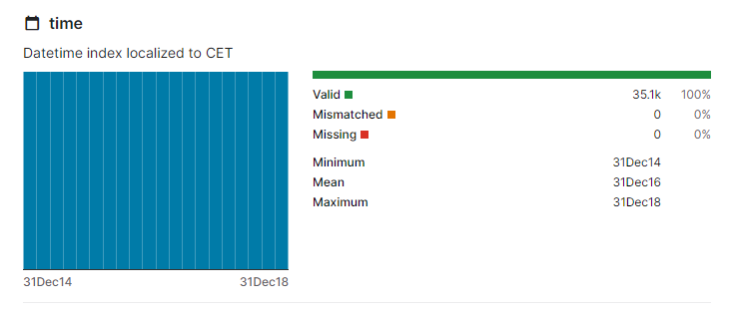
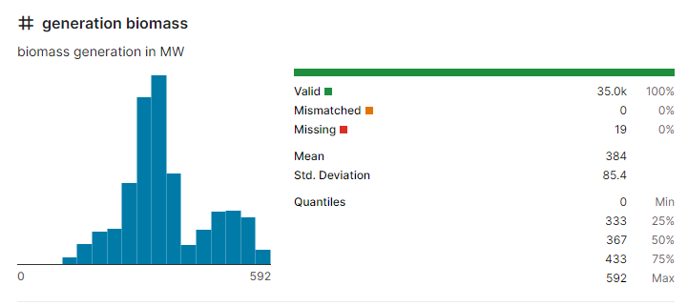
TIME
#GENERATION BIOMASS

Slide 12
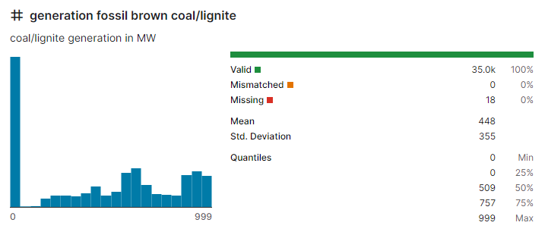
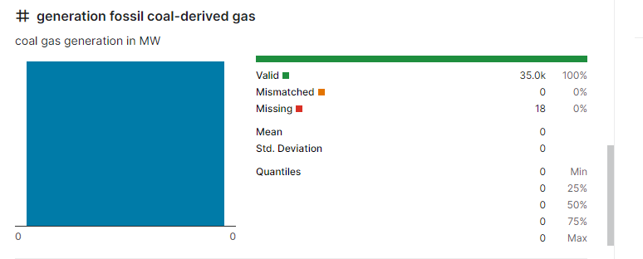
#Generation fossil brown coal
#Generation fossil coal-derived gas

Slide 13
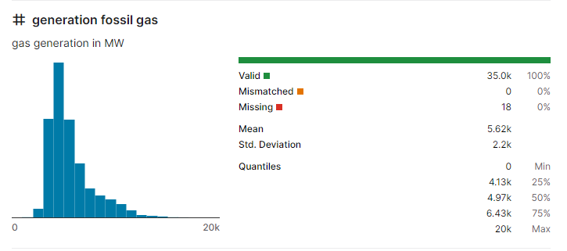
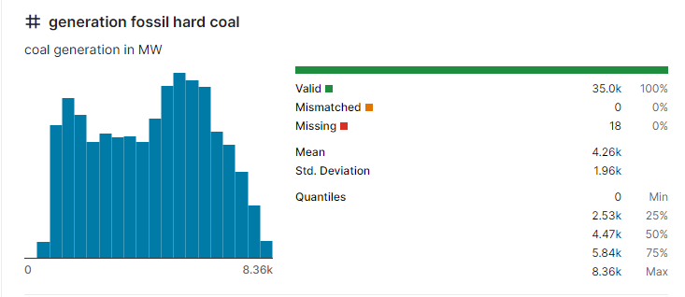
#Generation fossil gas
#Generation fossil hard coal

Slide 14
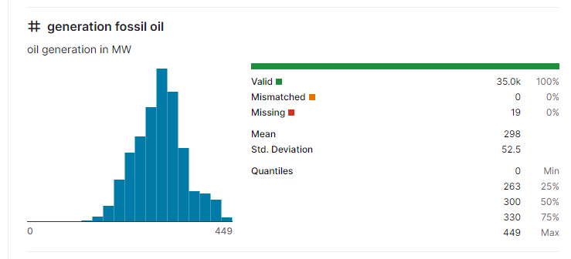
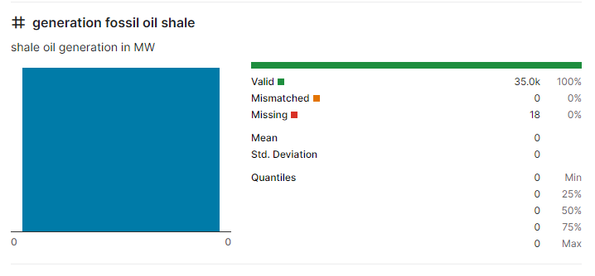
#Generation fossil oil
#Generation fossil oil shale

Slide 15
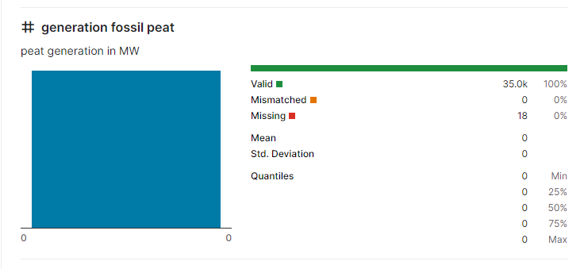
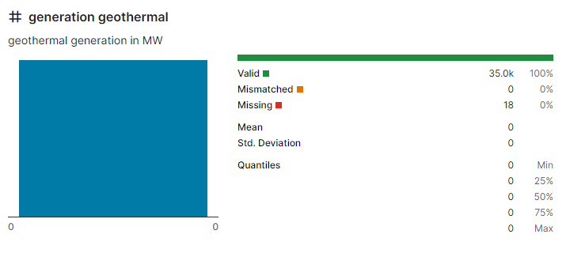
#Generation fossil peat
#Generation geothermal

Slide 16
DATA PREPROCESSING STEPS
Data cleaning: Handling missing values, outliers, and erroneous data points.
Data normalization or scaling: Scaling numerical features to have a consistent range (e.g., using min-max scaling or z-score normalization).
Feature engineering: Creating new features based on domain knowledge. For example, you can calculate rolling averages or cumulative statistics for certain variables.

Slide 17
Time-series decomposition: Separating the data into trend, seasonal, and residual components using methods like seasonal decomposition of time series (STL).
Lag features: Creating lagged variables (e.g., past electricity prices) to capture temporal dependencies.
Categorical encoding: Converting categorical variables (e.g., day of the week) into numerical form, typically using one-hot encoding.

Slide 18
FEATURE EXTRACTION TECHNIQUES
Feature extraction is crucial for improving the performance of electricity price prediction models. Here are some common feature extraction techniques:
Time-based features: Extract features related to time and date, such as hour of the day, day of the week, month, and year. These can capture daily, weekly, and seasonal patterns.
Lag features: Include lagged variables, which represent past values of the target variable (past electricity prices) or other relevant features. These can capture auto-regressive behavior in the data.

Slide 19
Rolling statistics: Compute rolling statistics, such as moving averages, moving sums, or standard deviations, to capture trends and fluctuations in the data.
Weather-related features: Incorporate weather data by extracting relevant features such as temperature, humidity, wind speed, and solar radiation. These can help account for the impact of weather on electricity prices.
Economic indicators: Include features related to economic data, such as fuel prices, GDP, and inflation, which can influence energy prices.
Market-related features: Incorporate data on supply and demand, transmission capacity, and market conditions. This can capture factors like generator availability and grid congestion.

Slide 20
MACHINE LEARNING ALGORITHM
Here are some commonly used machine learning algorithms for electricity price prediction:
ARIMA (AutoRegressive Integrated Moving Average):
ARIMA is a classic time series forecasting method that is well-suited for univariate time series data, such as historical electricity price data. It can capture seasonality and trends in the data.

Slide 21
LSTM (Long Short-Term Memory):
LSTM is a type of recurrent neural network (RNN) that is excellent for capturing long-term dependencies in time series data. It is particularly effective when dealing with sequences of data, making it suitable for time series forecasting tasks like electricity price prediction.
Prophet:
Prophet is a forecasting tool developed by Facebook that is designed for time series data with daily observations that display patterns on different time scales. It is especially useful for handling holidays and special events that can impact electricity prices.
XGBoost:
XGBoost is an ensemble learning algorithm, specifically a gradient boosting method, that is highly effective for structured data. It can capture complex relationships between features and provide accurate predictions for electricity prices.

Slide 22
Random Forest:
Random Forest is another ensemble learning algorithm that is suitable for both regression and classification tasks. It can handle a wide range of input features and is robust against overfitting.
SARIMA (Seasonal AutoRegressive Integrated Moving Average):
SARIMA is an extension of the ARIMA model that includes seasonality and can be particularly useful for capturing recurring patterns in electricity price data.
Neural Prophet:
Neural Prophet is an extension of the Prophet library that incorporates neural networks to capture complex patterns in time series data. It can be useful when the data has nonlinear dependencies.
Gated Recurrent Units (GRU):
GRU is another type of recurrent neural network similar to LSTM. It is less complex and can be faster to train, making it a good choice for medium-sized datasets

Slide 23
MODEL TRAINING
Data Preparation:
Collect and preprocess your historical electricity price data. This includes handling missing values, outliers, and scaling the data if necessary. Ensure that the data is in a format suitable for your chosen machine learning algorithm.
Feature Selection/Engineering:
Identify and select relevant features that may impact electricity prices, such as time of day, day of the week, season, weather conditions, electricity demand, and any other relevant factors. You may also need to engineer new features that can improve prediction accuracy.

Slide 24
Data Splitting:
Divide your dataset into three sets: training, validation, and test sets. Common ratios are 70% for training, 15% for validation, and 15% for testing. The training set is used to train the model, the validation set for hyperparameter tuning, and the test set to evaluate the model's performance.
Hyperparameter Tuning:
For many machine learning algorithms, there are hyperparameters that need to be tuned to optimize model performance. Use the validation set to experiment with different hyperparameters and choose the best combination. Techniques like grid search or random search can be helpful for hyperparameter optimization.
Model Training:
Train your chosen machine learning model on the training dataset. Depending on the algorithm, this may involve gradient descent (for neural networks), iterative optimization (for ARIMA), or boosting (for ensemble methods). The goal is to minimize the chosen loss function.

Slide 25
Model Evaluation:
After training, use the validation dataset to evaluate the model's performance. Calculate the selected evaluation metrics (e.g., MAE, MSE, RMSE, MAPE) to assess how well the model is performing. Adjust hyperparameters as needed based on the validation results.
Final Testing:
Once you are satisfied with the model's performance on the validation data, assess its performance on the test dataset. This step helps you determine how well the model generalizes to unseen data.
Post-Processing:
Depending on the algorithm, you may need to perform post-processing steps. For example, you might need to reverse any data transformations or make adjustments to the model's output to ensure it aligns with the original price scale.
Deployment:
If the model performs well on the test dataset and meets your criteria, you can deploy it for making real-time or batch predictions. Ensure that you have a process for updating and maintaining the model as new data becomes available.

Slide 26
EVALUATION METRICS
Common evaluation metrics for electricity price prediction include:
Mean Absolute Error (MAE):
MAE measures the average absolute difference between the predicted and actual electricity prices. It provides a straightforward interpretation of prediction errors.
Mean Squared Error (MSE):
MSE calculates the average of the squared differences between predicted and actual prices. Squaring the errors penalizes larger errors more heavily than MAE, which can be useful when you want to give more weight to large prediction errors.

Slide 27
Root Mean Squared Error (RMSE):
RMSE is the square root of MSE, providing an evaluation metric in the same units as the target variable. It is more interpretable than MSE because it's on the same scale as the actual prices.
Mean Absolute Percentage Error (MAPE):
MAPE measures the average percentage difference between predicted and actual prices. It is particularly useful when you want to understand the relative error in percentage terms.
R-squared (R2):
R2, also known as the coefficient of determination, measures the proportion of variance in the electricity prices that is explained by the model. A higher R2 value indicates a better fit of the model to the data.
Normalized Root Mean Squared Error (NRMSE):
NRMSE is an RMSE value normalized by the range of the target variable. It allows for the comparison of performance across datasets with different scales.

Slide 28
Mean Forecast Error (MFE):
MFE measures the average difference between predicted and actual values. Positive MFE values indicate overestimation, while negative values indicate underestimation.
Theil's U Statistic:
Theil's U Statistic is a metric that compares the accuracy of the predictions to a naïve forecast. It is particularly useful for assessing the predictive power of the model in relation to a simple baseline model.
Coverage Probability:
Coverage probability evaluates the model's ability to predict electricity price movements within a specified range. It is especially important for quantifying the model's reliability in financial applications.
Custom Metrics:
Depending on the specific requirements of your application, you may need to define custom evaluation metrics that capture unique aspects of electricity price prediction. For example, you might create a metric to penalize underestimations more heavily if they have a significant financial impact.

Slide 29
CONCLUSION
In conclusion, electricity price prediction is a crucial task for energy market participants and consumers. By leveraging machine learning algorithms and sound data preparation, we can develop accurate models for forecasting electricity prices. Proper model evaluation and selection of appropriate evaluation metrics are essential for assessing the model's performance. Ultimately, these predictions can lead to more informed decision-making, cost savings, and better resource allocation in the energy sector. As we continue to refine and optimize our models, we aim to contribute to a more reliable and efficient electricity market.

Slide 30
THANK YOU

